Slide 1
Metadata of job, Update of Kernel and simulation
Chi WANG
chiwang@mail.ustc.edu.cn

Slide 2
content
Why do we need metadata?
Update Kernel
DmpVAlg
DmpMetadata (in Event package)
Update simulation
How to use simulation?
How to modify your algorithms?
Plan

Slide 3
Why do we need metadata
What is metadata?
Whole job configuration
Job options(DmpVAlg::Set(option, argv))
Rotation of DAMPE, translation of DAMPE
Injection particle type
Max(min) energy, etc
Will we use them in the further?
Yes, same consideration for other jobs
The ability of recording any job options

Slide 4
Update Kernel package: DmpValg
Add a new event class: DmpMetadata
Delete DmpVAlg::std::map<string,string> OptMap
Add DmpVAlg::DmpMetadata *fMetadata

Slide 5
Update simulation
Why
Rotate DAMPE detector
Translate detector for Beam test
How to get right information of particle source?
Particle source is fixed
Detector has been moved…
Record the right direction and position of particle source (relative)
So, we need DmpMetadata
(modified some source code. Detail of modification, refer to code)
updated event of simulation
DmpEvtMCBgo -> DmpEvtBgoHits ( junction of simulation and real data)
DmpEvtBgoHits, real data will use it to create the input file of reconstruction

Slide 6
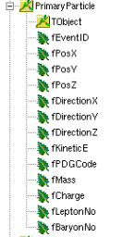
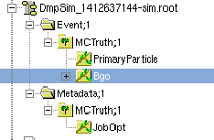
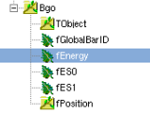
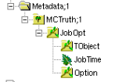
Output of simulation: DmpEvtBgoHits

Slide 7
How to use simulation?
Based on updated Kernel
Job option file, Options of simulation:
Choose mode:
simAlg.Set("Mode","Vis") # if NOT set, will use batch mode
Set magnetic field:
simAlg.Set("BT/Magnetic","1 0 0") # default is "0 0 0“
Set translation and rotation of DAMPE
(next package)

Slide 8
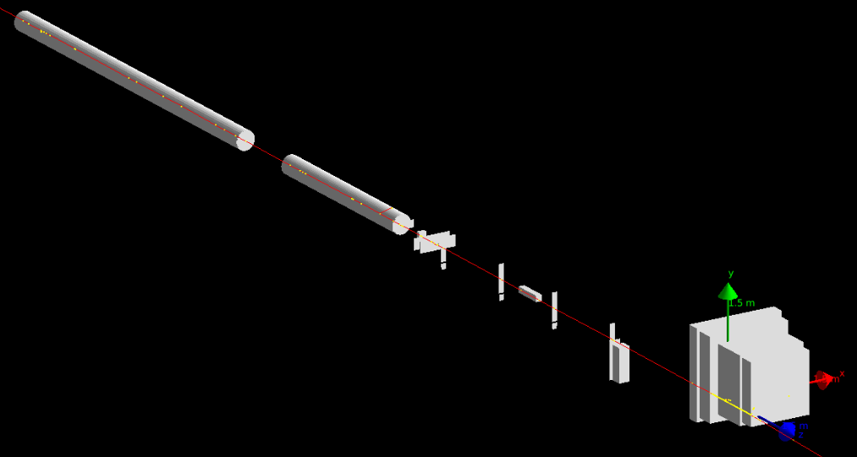
Simulation: Set translation
simAlg.Set("BT/DAMPE/Translation",“300 300 0")
# uint: mm. default is "0 0 0"

Slide 9
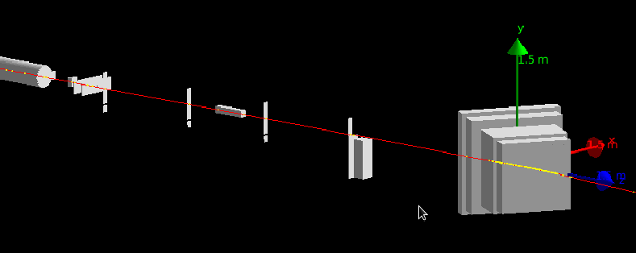
Simulation: Set rotation
simAlg.Set("BT/DAMPE/Rotation","30")
# unit: degree. Around Y axis
NOTE:
坐标系如图，包括真实数据重建出来的位置坐标都是以它（Bgo上表面中点）为参考
旋转平台的转动中心不在Y轴上，由模拟推算怎么设置旋转平台的调整（PMO？）

Slide 10
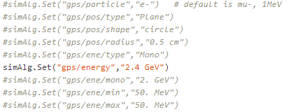
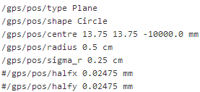
Simulation: Set GPS
No macro file any more!
All gps options are valid in job option file
*.mac
NOTE: NEVER use 2 commands
gps/direction // otherwise: flying out of beam pipe…
gps/centre // otherwise: source particle in detectors…

Slide 11
Plan
Digitization?
How long, if not have time before BT, skip this part
Update DmpEvtBgoHits::fES0 (fES1) // now is 0
Big data sample of simulation
Which particle energy, point, rotation(correspond to BT and physics)
Reconstruction algorithm
Combine all calibration packages
Input binary file
Output event class: DmpEvtBgoRaw
Parameters event classes: DmpEvtBgoPed (Other correction?)
Find Bgo hit (DmpAlgFindBgoHit?)
Input event class: DmpEvtBgoRaw
Output event class: DmpEvtBgoHits (junction of Simulation)
Parameters class: DmpEvtBgoMip, DmpEvtBgoAtt
Part 1
Part 2
Part 3

Slide 12
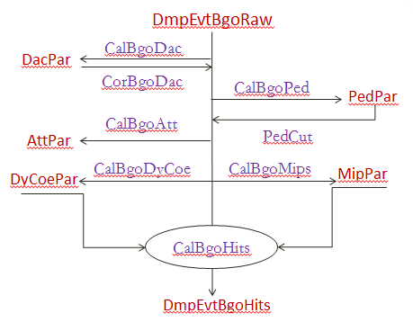
Part 1, 2, 3
Part 3
Combine Calibration
Part 1
Fix simulation
Part 2
Start reconstruction
and identification

Slide 13
Part 1, 2, 3
DmpAlgSim
必须精确检查代码，检查探测器搭建、材料等
否则到时大批模拟数据与实验不一致
关键：模拟和实验在这里一致
模拟10GeV electron，每个晶体的能谱，
实验10GeV electron，每个晶体的能谱
Part 2
Start reconstruction
and identification

Slide 14
模拟30°的旋转，实验时如何设置？
先设置实验平台（托DAMPE的台子）使得探测器x-z平面处于上下及左右移动的中心
这时，实验平台的旋转轴和Detector的 Y轴不重合
现在Simulation做30°的选择模拟，实验的时候单纯的旋转实验平台30°不能与模拟数据对比（PMO???）

Slide 15
Backup
Update of Kernel
How to modify your codes
Databuffer
Job option of writlist
No DmpVAlg::std::map<string,string> OptMap, replaced by DmpVAlg::DmpMetadata *fMetadata
A bug

Slide 16
Update Kernel: DmpRootIOSvc
DmpRootIOSvc::Set(string option, string value)
Option = Output/WriteList
Value: a tree name (NOW)
Value is a tree name, 2 level: folderName/treeName
last version: a branch name, 3 levels: folderName/treeName/branchName
So, will write all branches under this tree

Slide 17
Update kernel: DmpDataBuffer
RegisterObject()
Return void now, (last version, return bool)
If RegisterObject wrong, terminate this job automatically, so here return void now
ReadObject()
Split into two function:
If ReadObject return “0”
Means, need to invoke:
LinkRootFile(….)
LinkRootFile(…)

Slide 18
Bug
必须移动辅助探测器，而不是DAMPE
不然模拟拿到的坐标值全都需要移动或者旋转……
TODO：
Job option设置接口不变，用户直观
改代码，移动辅助探测器，计算入射粒子相对探测器的信息

